Slide 1
What all do we need to calculate our parameters?
Wall parameters (6) | Particle parameters (5) | Impact parameters (2) | Pair parameters (3)
Poisson’s ratio | Poisson’s ratio | Initial collision velocity | Coefficients c3,c4 – account for deviation from experimental results
Young’s modulus | Young’s modulus | Impact angle | Friction coefficient
Density | Density
Yield strength | Yield strength
Hardness | Hardness
Coefficient Ch – accounts for heat dissipation

Slide 2

User : I will give impact velocity, impact angle and (wall,particle) pair, hit enter and close my eyes….
Particle
?
Surface

Slide 3

If we listen to the user, what should input to code look like?
User input -----> $v_{i},α,\left(wall,particle\right)$
file1.txt
file2.txt
Database

Slide 4

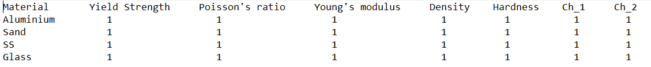
file1.txt
How should file1.txt and file2.txt look like?
file2.txt

Slide 5
Code structure
Step 1: User gives (wall,particle) pair as 1st input
The code reads file1.txt and finds this (wall,particle) pair in the file.
The code stores values of friction coefficient, c3, c4 in variables.
The code stores the wall, particle strings in separate string variables.
Example: If (wall,particle) =
wall_string =
particle_string =

Slide 6
Code Structure (Contd)
The code reads file2.txt and finds wall_string and particle_string in the file.
Stores material property values of wall and particle in separate variables.

Slide 7

Code structure (Contd)
Step 2: User gives impact conditions, $v_{i},α$
The code calculates all parameters - $e_{n},e_{t},E_{p},E_{D},E_{c},E_{kR},etc.$

Slide 8
Robustness of code
Only need to change file1.txt and file2.txt if additional (wall,particle) pair are to be simulated.
Simple text editor such as notepad is used over Excel, which gives more freedom to the user.
Same design idea can be incorporated in other programming language.

Slide 9
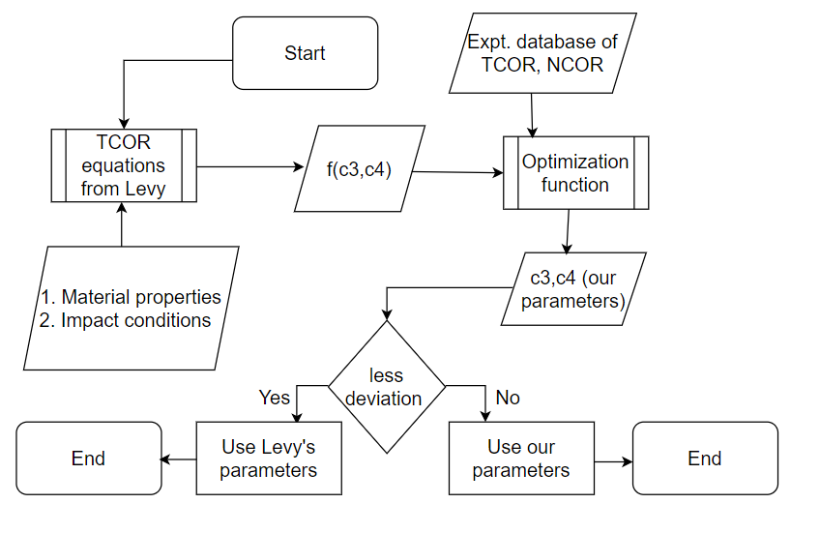
Flowchart for establishing fitting parameters

Slide 10
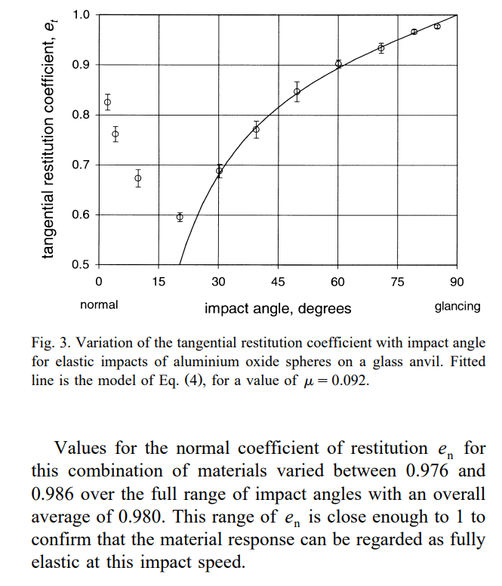
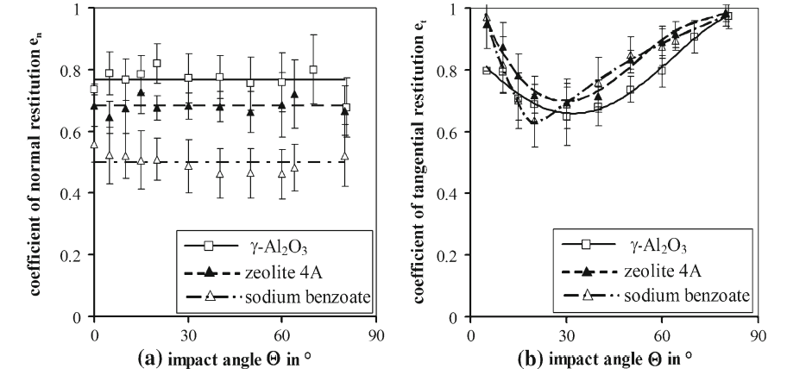
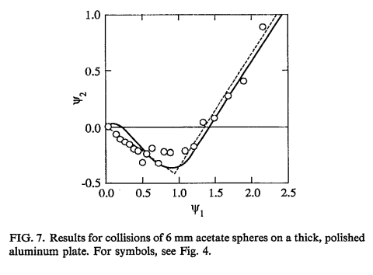
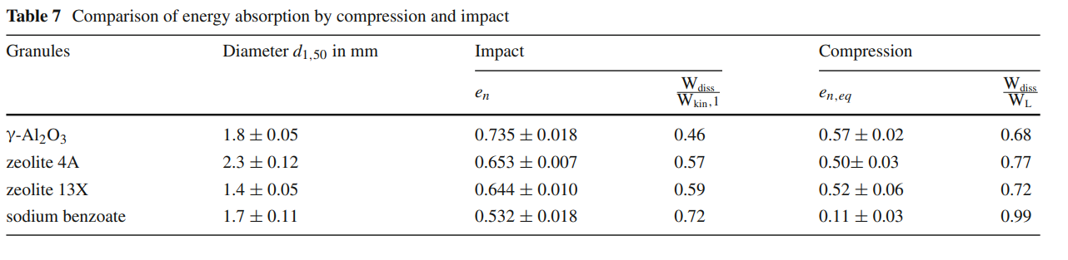
Expt. database of NCOR, TCOR

Slide 11
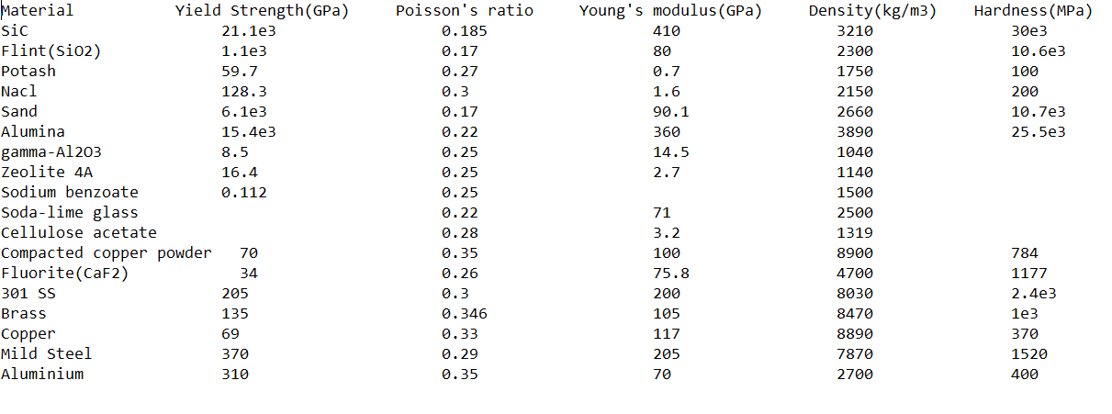
Database for material properties and impact conditions

Slide 12
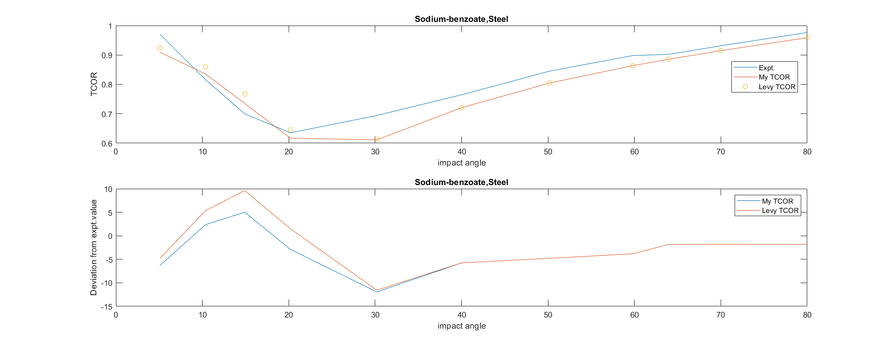
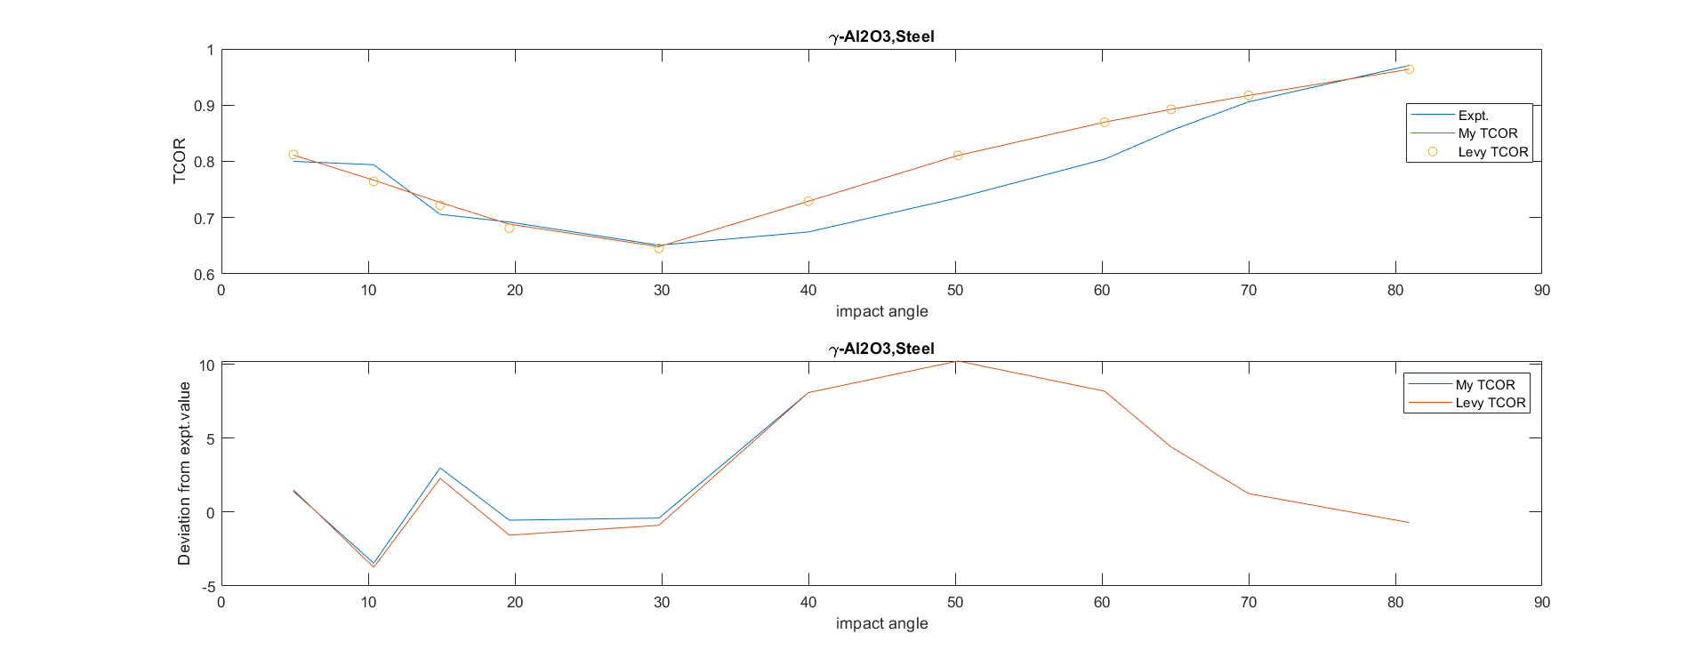
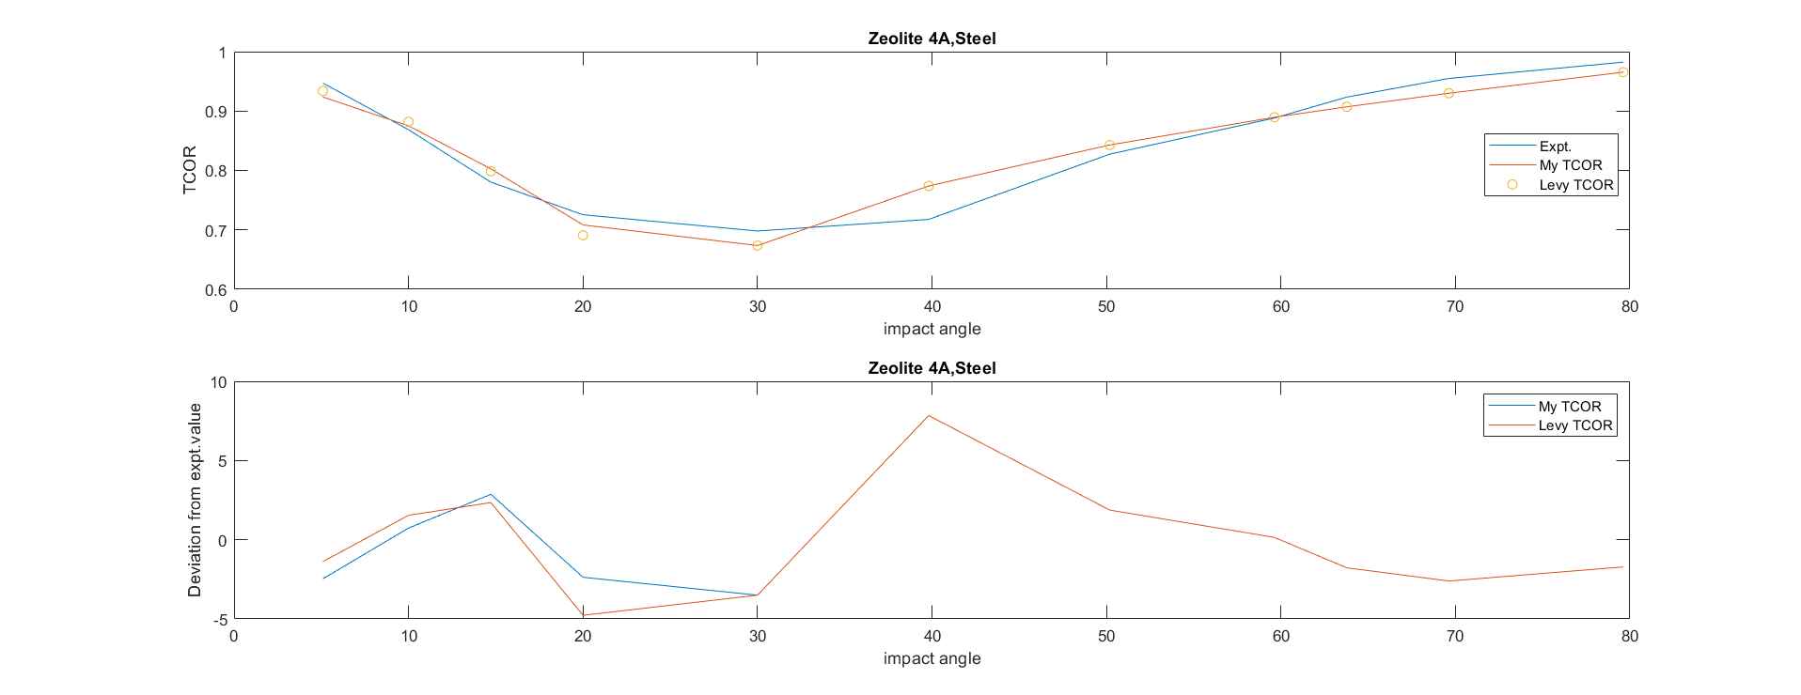
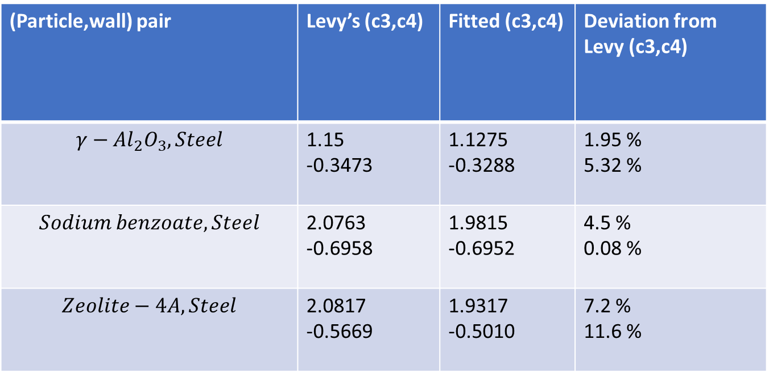
Some preliminary results on fitting parameters
(Particle,wall) pair | Levy’s (c3,c4) | Fitted (c3,c4) | Deviation from Levy (c3,c4)
$$γ−Al_{2}O_{3},Steel$$ | 1.15 -0.3473 | 1.1275 -0.3288 | 1.95 % 5.32 %
$$Sodium benzoate,Steel$$ | 2.0763 -0.6958 | 1.9815 -0.6952 | 4.5 % 0.08 %
$$Zeolite−4A, Steel$$ | 2.0817 -0.5669 | 1.9317 -0.5010 | 7.2 % 11.6 %
Reference: Antonyuk, S., Heinrich, S., Tomas, J. et al. Energy absorption during compression and impact of dry elastic-plastic spherical granules. Granular Matter 12, 15–47 (2010).

